Slide 1
From Idea to I/EP: A Practical, Hands-on Workshop on Writing an Archives of PM&R Information/Education Page
Abiodun E. Akinwuntan, PhD, MPH, MBA, MIH, Dean & Professor, University of Kansas Medical Center
Alison M. Cogan, PhD, OTR/L, Assistant Professor, University of Southern California
Co-Chairs, ACRM Communications Committee

Slide 2
DISCLOSURES
Abiodun Akinwuntan and Alison Cogan, faculty for this educational event, have no relevant financial relationships with ineligible companies to disclose.
Abiodun Akinwuntan and Alison Cogan, faculty for this educational event have no non-financial conflicts of interest relevant to this activity.

Slide 3
LEARNING OBJECTIVES
At the conclusion of this activity, the participant will be able to:
Learn the skill of identifying a suitable I/EP topic.
Practical hands-on experience of developing an I/EP.
Determine if the I/EP is well-written.
Upload an I/EP to the Editorial Manager.

Slide 4
OVERVIEW
What is an I/EP?
Exploring your I/EP Idea
Writing an I/EP
Submitting your I/EP
Notes:
This will be a practical hands-on and interactive presentation. Participants will have the opportunity to go through and participate in the full process of determining a suitable I/EP topic and the suggested processes involved in developing the manuscript. Participants are encouraged to bring ideas of future I/EP that they intend to write with them. Such ideas may be become the topic of the interactive session. First, we will work through the process of exploring an idea for an I/EP, identifying the target audience, conducting and environmental scan, and clarifying the purpose. Next, we will address the writing process and the differences from typical academic writing. We will discuss strategies for writing clearly and concisely for the target audience. The session will include didactic content as well as “hands on” activities in which attendees can begin the initial steps of developing their own I/EPs.

Slide 5
What is an I/EP?
Information/Education Page
Brief (2-page) sheets that provide consumer-friendly information on topics relevant to rehabilitation medicine
Published in the Archives of Physical Medicine and Rehabilitation
Intended to be “tear out sheets” from print version of Archives, but frequently downloaded as PDFs
Printed with accessibility in mind – larger print than a regular article

Slide 6
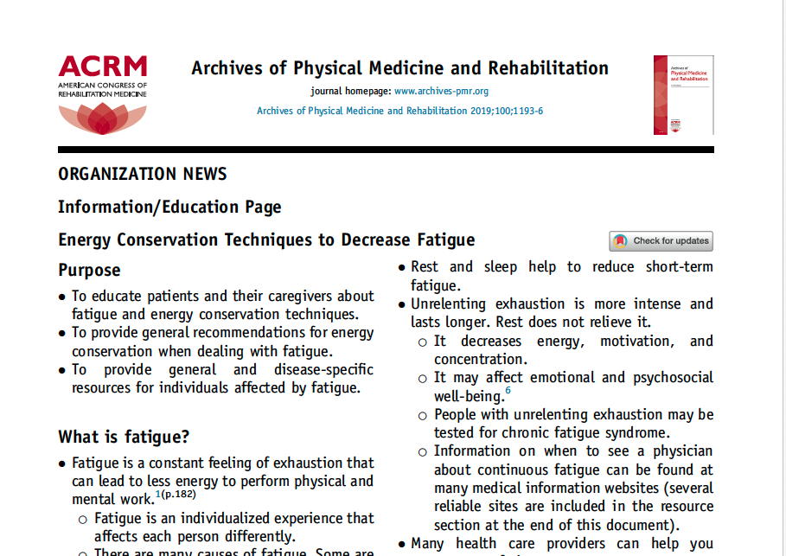

Slide 7
Exploring your I/EP Idea
Defining your idea
Identifying the target audience
Conducting an environmental scan
Clarifying your purpose

Slide 8
First Step: Review the I/EP Guidelines
https://acrm.org/wp-content/uploads/pdf/Information-Education_Pages.pdf
Consider reviewing guidance for I/EP reviews: https://acrm.org/wp-content/uploads/2023/10/IEP_review_guidance_July2023-1.pdf

Slide 9
Defining Your Idea
Ideas come from many places
  New research findings
  Clinical practice experiences
  Feedback or questions from consumers
  Discussions with colleagues
Need to clearly define a resource gap – what do you think is needed and who needs it?
Who can you collaborate with? Who has relevant expertise?

Slide 10
Identifying Your Target Audience
Whom do you think would benefit from an I/EP on this topic?
  Consumers? Rehabilitation professionals?
  Be as detailed as possible!
  Tip: If you think your topic applies all consumers and/or all professionals, it is too broad. Be more specific!
What background information on your topic is your audience likely to know? What information is new to them?
  Talk to members of the target audience

Slide 11
Conducting an Environmental Scan
Archives does not publish I/EPs that duplicate information that is readily available from other sources
Start by Googling your topic
Also check other easily available sources
  Condition-specific organizations (e.g., Parkinson’s Foundation)
  Model Systems information sheets for TBI, SCI, burns
  WebMD, Mayo Clinic, Cleveland Clinic, and similar reputable online sources
If there are existing sources, is there still a need? Can you tailor your I/EP idea to add value?

Slide 12
Clarifying Your Purpose
If there are already existing resources that cover your topic:
  Refine the topic and/or target audience to add unique value, OR
  Move on to a new idea
If there are no existing resources on your topic:
  Still consider refining the topic and/or target audience
Draft a brief description and email the ACRM Communications Committee Co-Chairs to confirm topic is aligned with aims and scope of the Archives
  http://www.acrm.org/about/committees-groups/
Notes:
Note that Communications Committee pre-screen is not required to submit, nor does it guarantee acceptance

Slide 13
When is an I/EP not appropriate?
Replacement/substitute for original research articles
Introduction of new concept or health condition
Opinion or commentary
Marketing for a product or service
Platform to present novel interventions
Literature review
Recommendations that are not based on current evidence
Duplication of information that is readily available from other sources

Slide 14
ACTIVITY
Individually or in a small group, choose an idea for an I/EP
  What is the purpose of the I/EP?
  Who is the target audience?
Google the topic – what comes up?
Check at least one other source to see if there is similar content on your topic
  Can you revise your topic to address a unique need?

Slide 15
Writing Your I/EP
How I/EPs are different from typical academic writing
Word count vs. length
Citing the evidence
Notes:
writing process and the differences from typical academic writing. We will discuss strategies for writing clearly and concisely for the target audience

Slide 16
How is writing I/EPs different?
Not a review of the literature – focus on key message
Written in second person point of view, as if you are speaking directly to the target audience (“you” language)
Convey important messages with figures, graphs, bulleted lists, and other visual tools to improve readability
Consider: What actions or behavior changes do you want readers to take after reading the proposed I/EP?

Slide 17
Word Count vs. Length
I/EPs are limited to 1200-1400 word count, BUT
  Reduce word count to account for space taken by tables and figures
  Remember – I/EPs are intended to fit on a single 2-sided page!
  Bullet points, figures, tables, and graphs are strongly encouraged
Bulleted Lists
Graphs
Figures
Tables

Slide 18
Writing Your I/EP
Aim for 8th grade reading level, even for I/EPs aimed at rehabilitation professionals
  Tools available within MS Word, or online (look for Flesch-Kincaid grade level score)
    https://goodcalculators.com/flesch-kincaid-calculator/
Write in second person point of view (“you” language)
Keep sentences short and succinct
Avoid acronyms and jargon
Incorporate figures, tables, bulleted lists etc. to improve readability

Slide 19
Citing the Evidence
I/EPs are limited to 12 references maximum
Choose the most current and salient references for your topic
Any recommendations for action or behavior change must be evidence-based
Consider including links to additional resources as part of your I/EP and separate from the reference list

Slide 20
Review by Target Audience
Although not required, you are strongly encouraged to invite one or more representatives from your target audience to review your I/EP draft
Ask specific questions :
  Is there any part that they do not understand?
  What do they think is the key message?
  What actions would they consider taking after reading the I/EP?
Review is recommended even if a consumer is a co-author

Slide 21
I/EP Dos and Don’ts
DO
DO NOT
Keep language clear and simple
Convey important information through figures, tables, graphs, and bulleted lists
Engage members of your target audience in the writing and editing process
Use acronyms to circumvent word count limits
Include large blocks of text
Include multiple figures and tables in addition to 1400 words of text

Slide 22
ACTIVITY
Identify potential coauthors for your I/EP idea
  Could include members of an ACRM community group, or other colleagues with relevant expertise
Identify members of the target audience who could serve as co-authors or reviewers

Slide 23
Submitting Your I/EP
Preparing your submission
Submitting on Editorial Manager
Review Process
Common reasons for rejection

Slide 24
Preparing Your Submission
Ensure your completed draft adheres to I/EP Guidelines
Follow author instructions for Archives
12-pt font, single spaced, single column
Include all author information and attribution to an ACRM ISIG, Networking Group, or Task Force if appropriate
  Do not include author bios

Slide 25
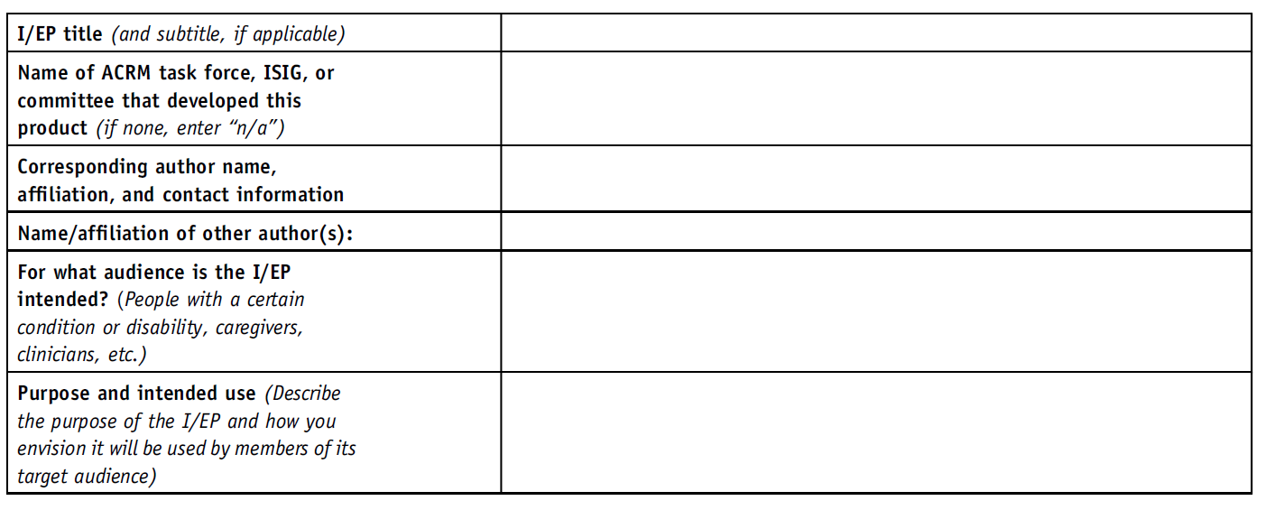
Cover Letter
Include a cover letter with your submission that includes the following:

Slide 26
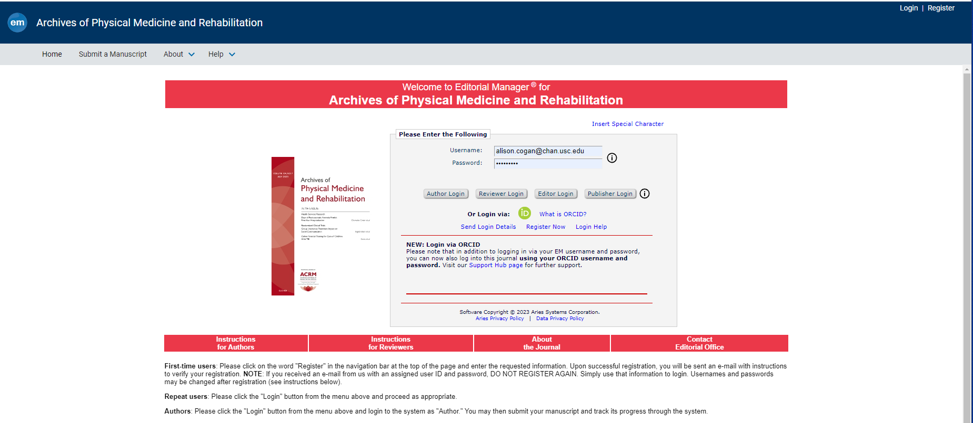
How to Submit
https://www.editorialmanager.com/archives-pmr/
Notes:
Alison

Slide 27
Review Process
Author submits I/EP through EM
Managing Editor Assigns to Co-Chair
Co-Chair reviews for quality
Quality acceptable
Co-Chair invites reviewers
Reviewers complete and submit comments
Co-Chair reviews comments & makes decision
Quality unacceptable
Reject without further review
Accept?
Feedback provided to author
No
Accept with minor revision or
Request for major revision
Accept with minor revision, Request for major revision, or Reject
Yes
I/EP enters publication pipeline
All coauthors must complete ICMJE forms
Author notified of Acceptance
Authors can check status on EM
Check your junk email folder regularly!
Notes:
Topic may be good, and even pre-clearance with chairs does not guarantee acceptance – quality and content/adherence to format are still required
Chair is not responsible for editing

Slide 28
Review Criteria
Addresses a relevant rehabilitation topic
Based on up-to-date evidence
Has a clearly defined target audience
Has a simple, easy-to-remember, and clinically relevant message
Does not duplicate information that is readily available elsewhere
Clear writing with short sentences at the appropriate reading level
Incorporates bulleted lists, figures, and tables
Notes:
Alison
*This is the same info that is on the checklist about developing an I/EP – and also how we evaluate
Addresses a relevant rehabilitation topic
Based on up-to-date evidence
Has a clearly defined target audience
Has a simple, easy-to-remember, and clinically relevant message
Does not duplicate information that is readily available elsewhere
Clear writing with short sentences at the appropriate reading level
Incorporates bulleted lists, figures, and tables

Slide 29
Common Reasons for Rejection
Information duplicates other sources
Too much information
Over recommended length
Language is too complex and unclear
Presents an opinion or position statement
Includes new, untested tools or recommendations
Excessive and in-depth detail about a topic already known by intended audience

Slide 30
Questions & Discussion
Contact:
  Abiodun Akinwuntan: aakinwuntan@kumc.edu
  Alison Cogan: alison.cogan@chan.usc.edu

Slide 31
OBTAINING CME/CEU CREDIT
Credit is only given to attendees after:
Successful completion of the entire course/session.
Completion of the course quizzes and evaluations and final conference evaluation.
After completing all required tasks, a certificate is downloadable from the task page on the website/conference app.
The evaluation system will close 30 days after the end of the event.

Slide 32
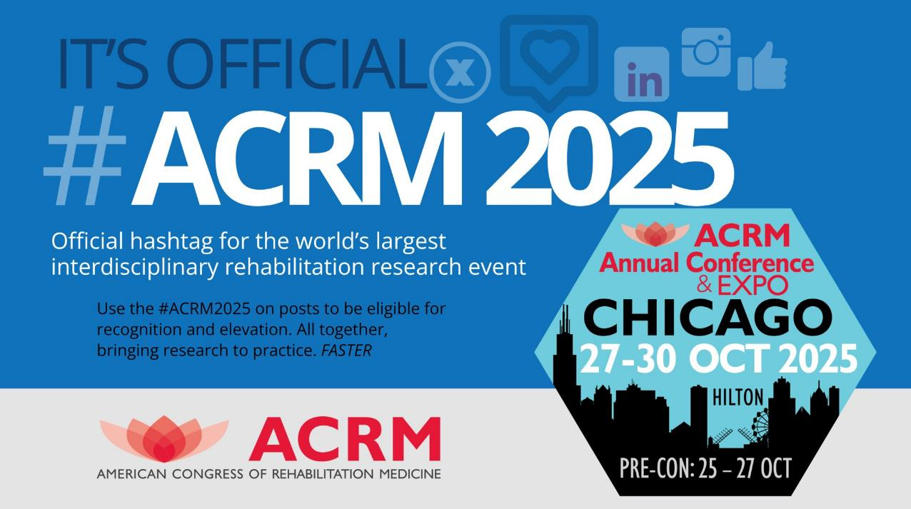
ACRM2024 Hashtag
Notes:
ACRM Annual Conference Logo

Slide 33
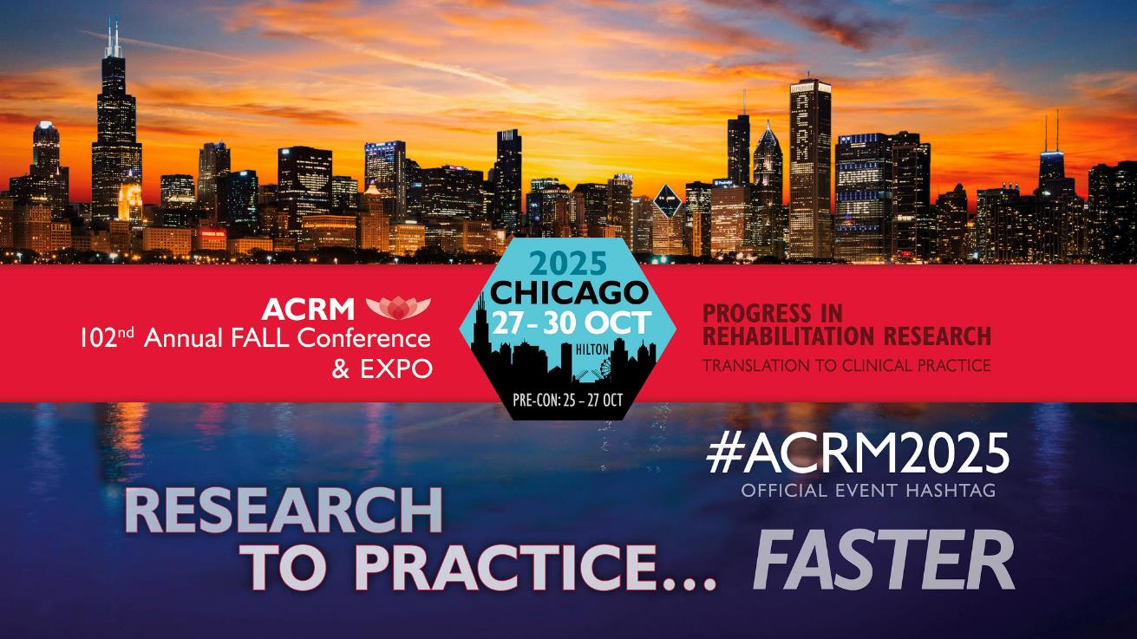
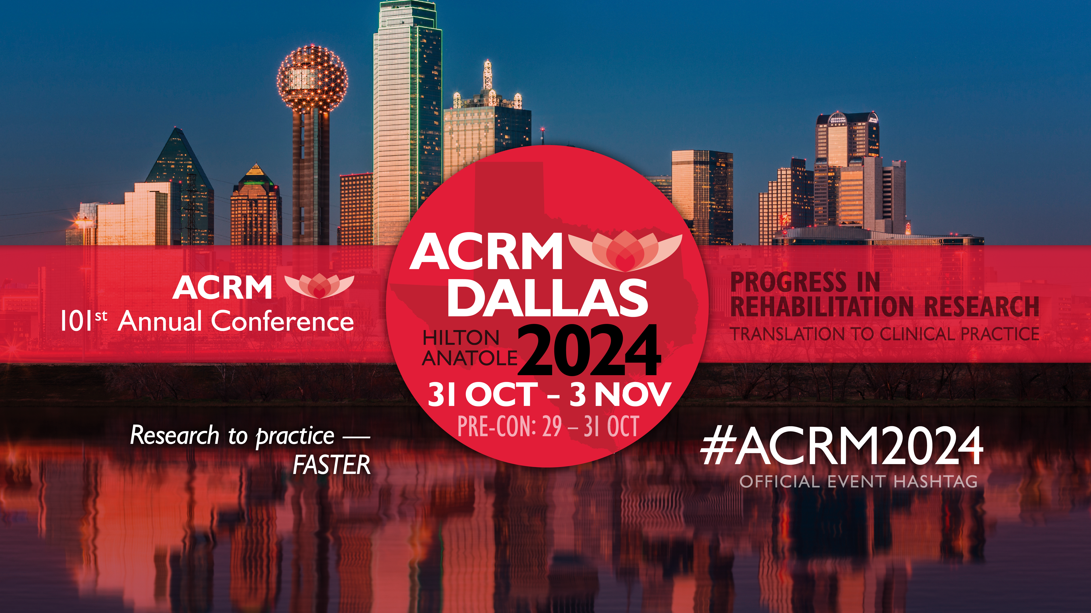

Slide 34



Slide 35

ACRM Annual Conference Reach

Slide 36

ACRM COMMUNITY
100+ GROUPS
Interdisciplinary Special Interest Groups, Networking Groups, Task Forces
Grow with us
There’s room for you here

Slide 37

Visual of ACRM’s Groups and Logos
Notes:
Visual of ACRM’s groups and logos.
Text: Research to Practice Faster Through Interdisciplinary Community

Slide 38


ACRM Logo and website address
ACRM.org
Notes:
ACRM Logo and website address

Slide 39


