Slide 1
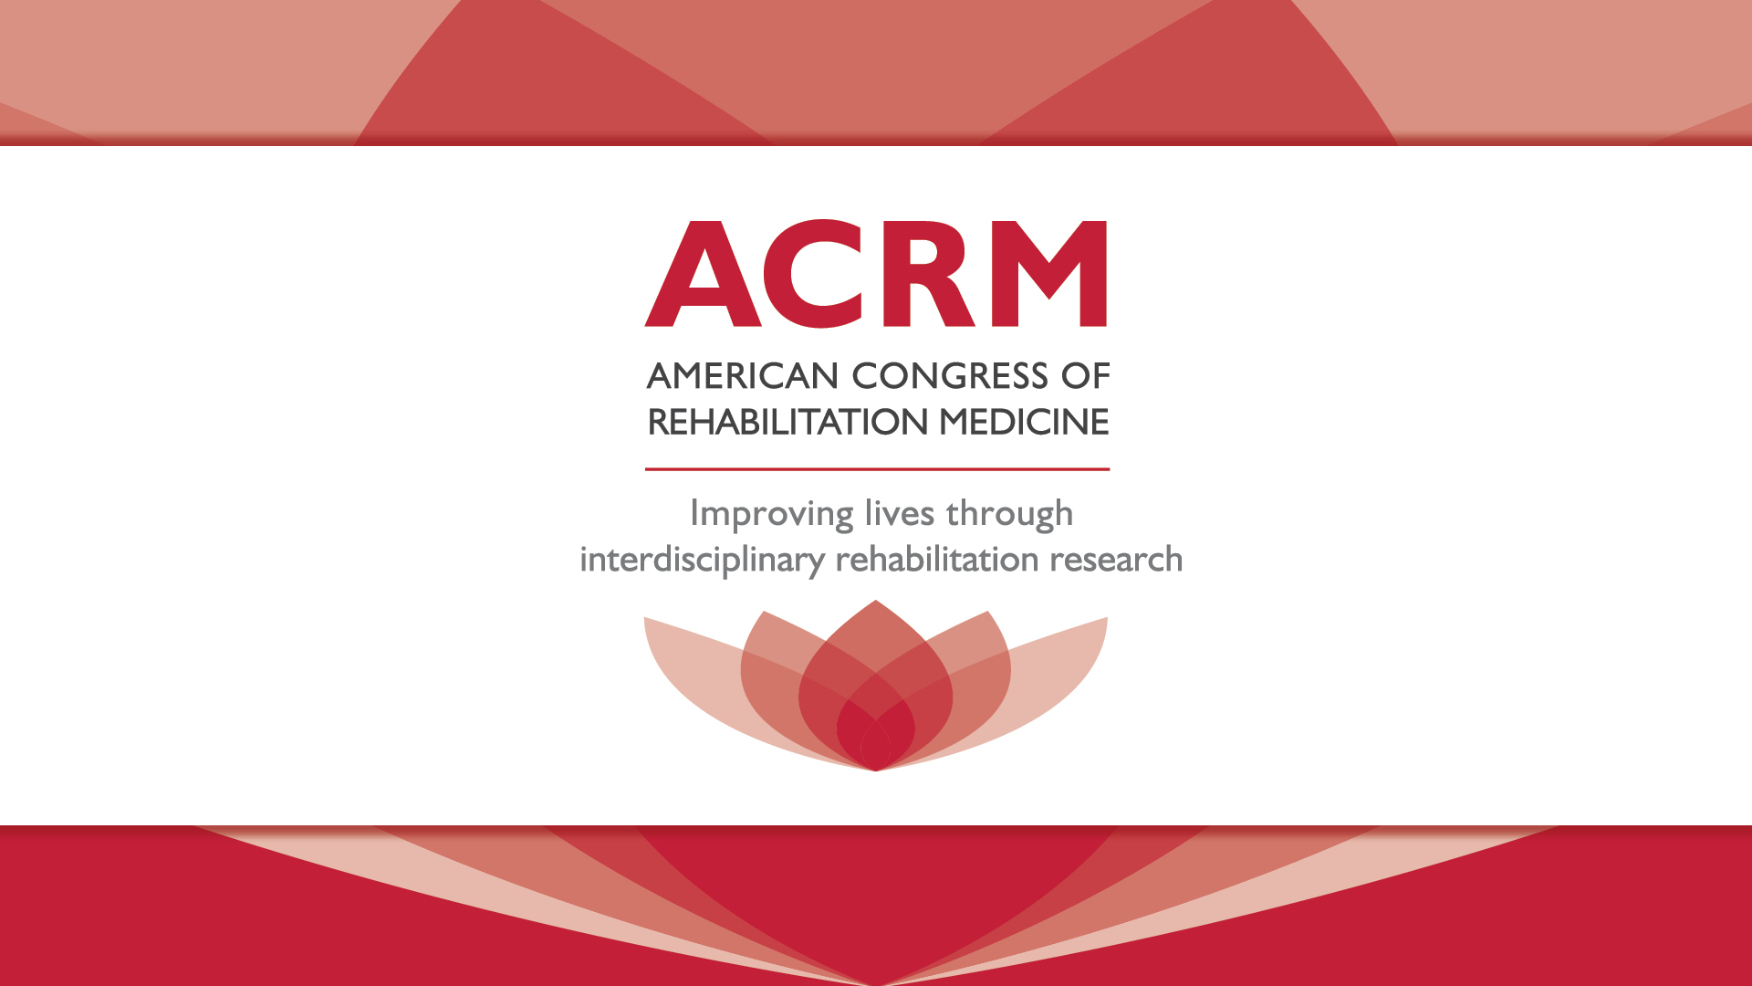
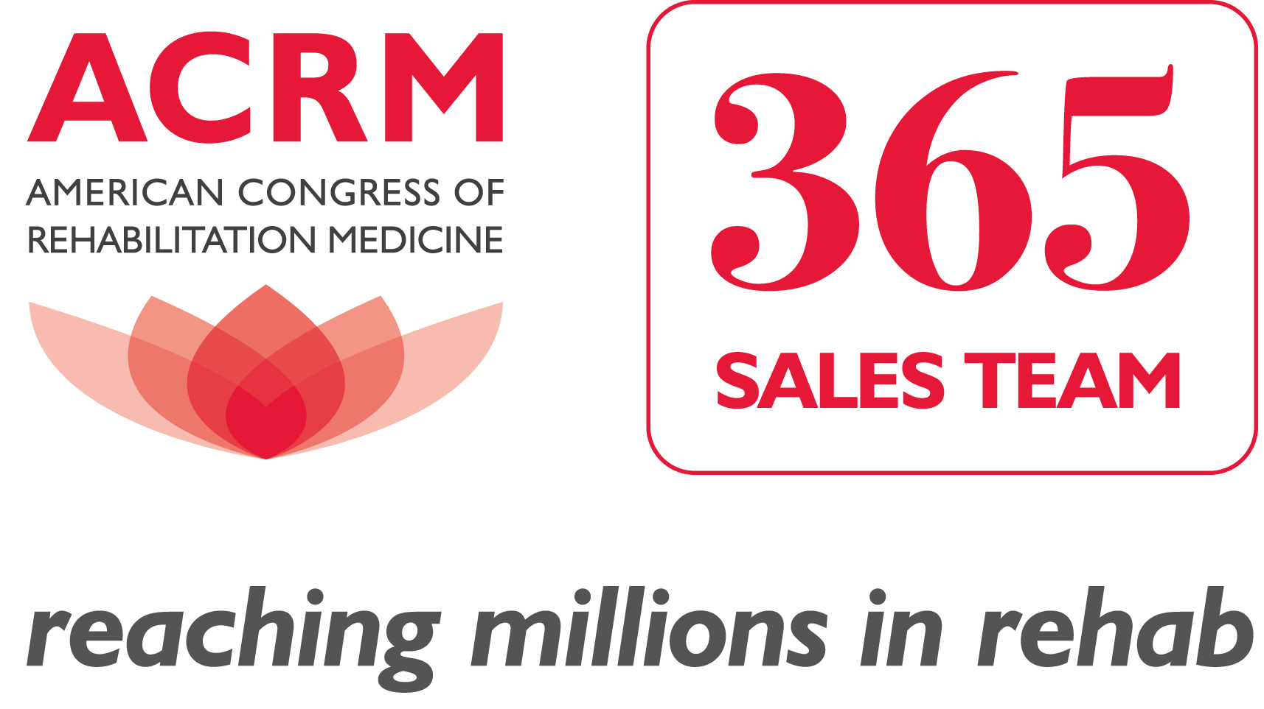
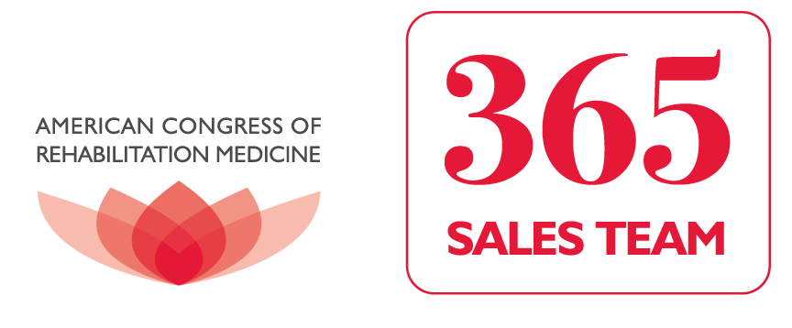
sponsorships | exhibiting | advertising | Institutional Support Program

Slide 2


ACRM Institutional Support Program (ISP)
With the mission to improve the lives of those living with disabling conditions, ACRM has the largest reach, the highest level of technology and the greatest overall value for reaching your prospects and generating sales leads.
Notes:
ACRM has the biggest and best global reach

Slide 3

ACRM 6M™ MODEL
MANAGEMENT
MEDIA
MEMBERSHIP
MARKETING
MEETINGS
MISSION
ACRM VALUE in all of the ‘M’s
Notes:
ACRM brings value

Slide 4
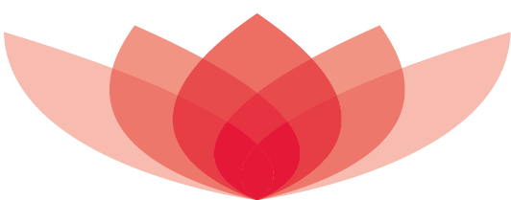
ABOUT ACRM — MANAGEMENT
With 6.6% management overhead, ACRM has the lowest in the industry. This means that ACRM is able to offer incredible value to our partners.
ACRM passes the savings on to you and offers the greatest reach for your investment
Notes:
Change BOG wording – they are not management. Low management cost allows us to give incredible value (big reach for less dollars)

Slide 5
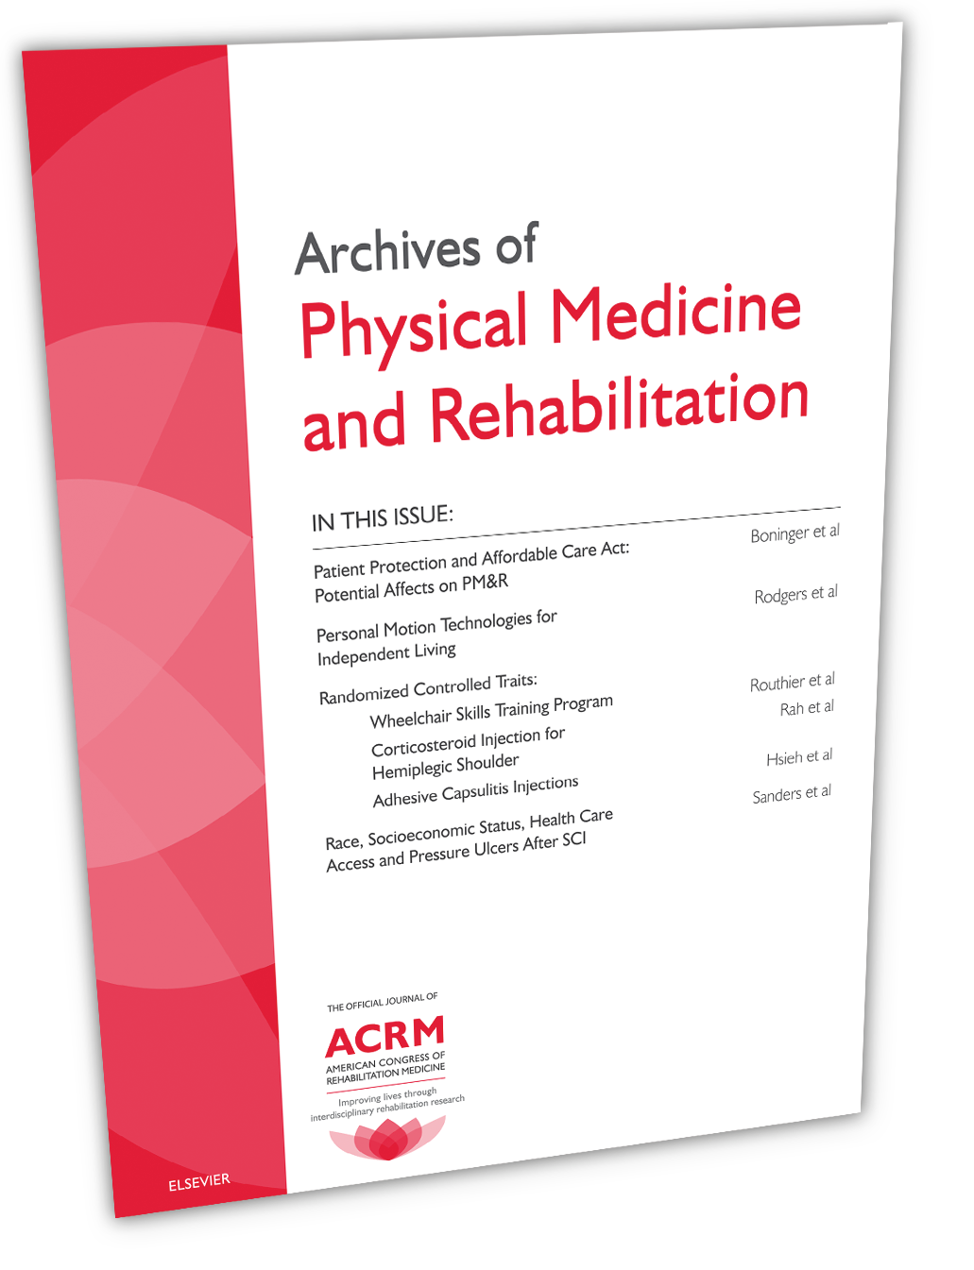
ABOUT ACRM — MARKETING
ACRM has the Greatest Global Marketing Reach in PM&R — IN PRINT, IN PERSON and ONLINE.
The ACRM 365™ Sales Team will
help you reach your most-likely sales prospects and achieve your business goals.
Notes:
Move up to first of the M’s – trademark for 365
+ 365 sales team logo to the corner of each slide

Slide 6
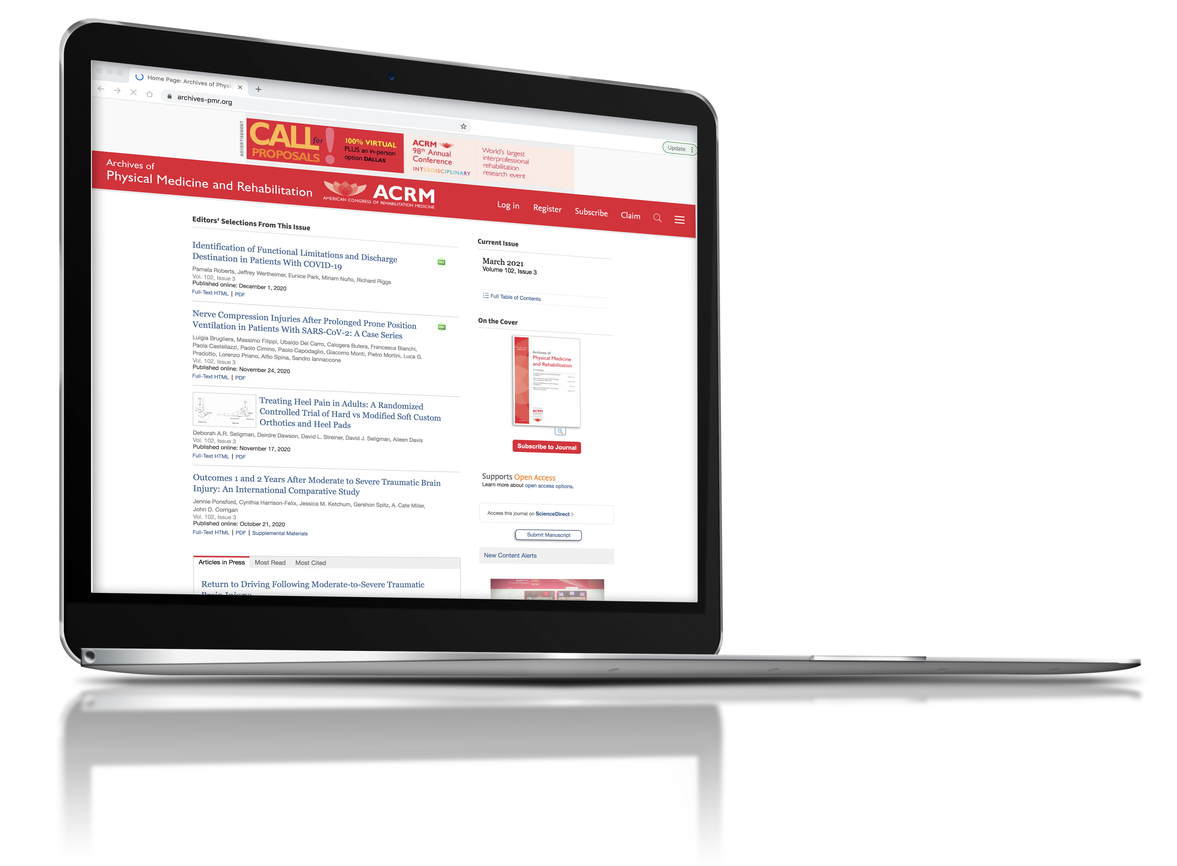
ABOUT ACRM — MEDIA
ACRM publishes the ARCHIVES of PM&R and ARRCT
The Archives of PM&R is THE Largest Medical Journal Advertiser in Kantar Report (2021)
ARCHIVES of PM&R Impact Factor increase: 28% TO 3.966
Total Journal article downloads: 3,100,000+ per year
ACRM has the Largest OPEN ACCESS journal program in the PM&R space
Social media: 65,000+ followers across 100+ channels
ACRM.org website visits: average 61,935 per month and Growing Fast
Together these represent the largest PM&R journal publishing program in the world
Notes:
Most powerful medical journals of PMR – globally – keep the stats the same
Together they represent the largest PM&R journal publishing program in the world

Slide 7

ABOUT ACRM — MEETINGS
The Largest Meetings in the World for Physical Medicine & Rehabilitation
ACRM Annual Conference
3,300+ conference registrations
500+ research papers and posters
400+ hours of in-person/recorded CME/CEUs
250+ symposia
120+ exhibitors and sponsors
ACRM Spring Meeting
Fantastic networking
Educational content with CME/CEUs
Meeting space for the ACRM Community Groups and Task Forces working on collaborative projects.
Notes:
Largest/best meetings in the world for PMR.
Likes the bullets on the left, add bullets to the right
Change header to ‘best meetings in the world’

Slide 8
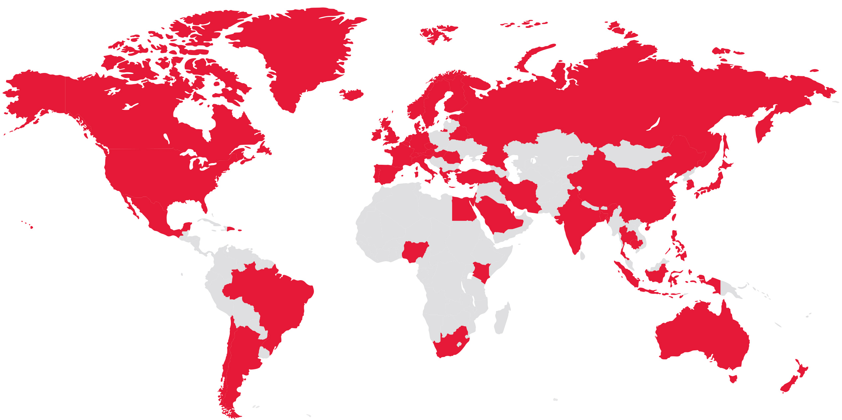
ABOUT ACRM — MEMBERSHIP
82,500+ members and growing
65+ countries
The largest membership for PM&R in the world
Notes:
“and growing” after countries
Biggest membership for PMR in the world

Slide 9
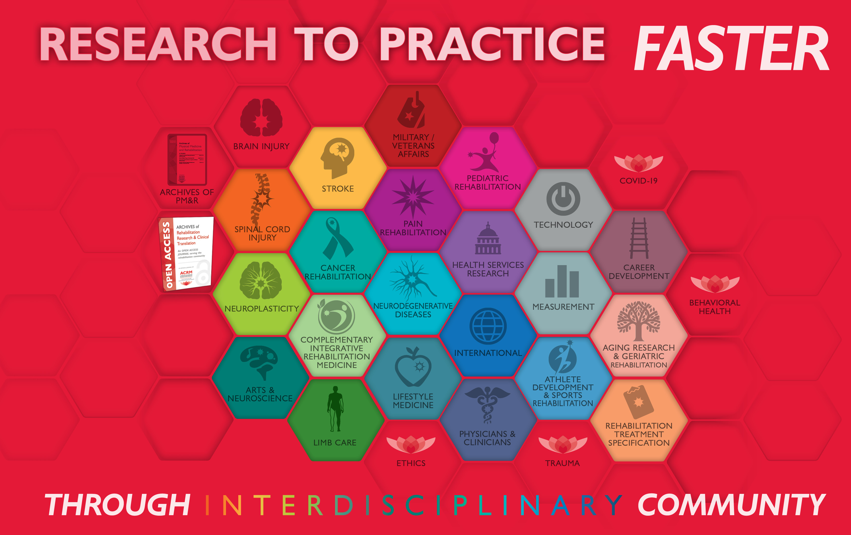
ABOUT ACRM — MISSION
ACRM is a 100-year-old non-profit association with the mission of IMPROVING THE LIVES of those with disabling conditions through interdis­ciplinary rehabilitation research in the disciplines of: brain injury, spinal cord injury, stroke, neurodegenerative diseases, cancer, chronic pain, limb loss, and MORE.
Notes:
Improving lines – change the color to make it stand out, JL suggested red

Slide 10
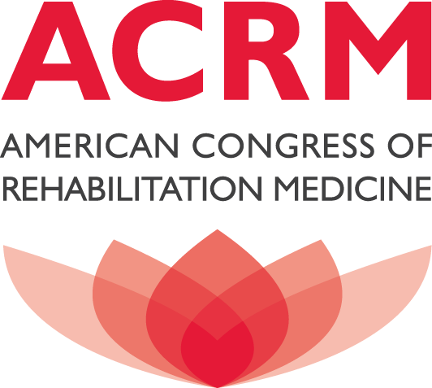
ACRM INSTITUTIONAL SUPPORT PROGRAM
ACRM Institutional Support Program offers exceptional reach and tremendous value. The more invested with ACRM, the more money saved and the greater return to you.
Notes:
More value/greater/better value – greater value than anywhere

Slide 11
ACRM INSTITUTIONAL SUPPORT PROGRAM
With your support ACRM will continue to:
Deliver a world-class educational event – the ACRM Annual Conference – providing a forum for sharing the latest in PM&R research while proving hundreds of hours of CME/CEUs to attendees
Provide year-round educational opportunities with our community webinar program
Contribute to the scholarly research with practice guidelines, original research and systematic reviews, information/education pages, measurement tools and supplements
Provide comprehensive cognitive rehabilitation training
Develop the current and next generation of rehabilitation research leaders through our Career Development Program
Promote the work of researchers around the world with our vast social media network
Expand our Open Access publishing program both in the Archives of PM&R and ARRCT – bringing valuable research to the entire world
Your investment strengthens ACRM and the Institutional Support Program, which strengthens your return and the mission.
Notes:
ISP support gets reinvested in ACRM – improves investment/reach.
Improve overall organization, strengthens ACRM, strengthens the program, which strengthens those involved

Slide 12
ACRM INSTITUTIONAL SUPPORT PROGRAM (ISP)
ISP LEVELS & DISCOUNTS – 2022
SUPPORT LEVEL | VALUE | DISCOUNT |  | YOUR COST ONLY
Cornerstone | $100,000 |  | 25% | $75,000
Platinum | $50,000 |  | 20% | $40,000
Gold | $25,000 |  | 15% | $21,250
Silver | $15,000 |  | 10% | $13,500
Bronze | $5,000 |  | 5% | $4,750
Developed for maximum flexibility, your “VALUE” dollars never expire!
Each calendar year (1 JAN – 31 DEC) a minimum of $4,750 must be invested to remain active in the ACRM Institutional Support Program.
Notes:
New 2022 pricing
Official pricing for 2022 begins
Give them whatever deal is best for them

Slide 13
ACRM INSTITUTIONAL SUPPORT PROGRAM (ISP)
What You Can Receive With Your Investment
  Tradeshow Booth — IN-PERSON & VIRTUAL
  ACRM Memberships
  Sponsorships
  Conference Registrations
  Advertising with ACRM and/or its Journals:
    Archives of PM&R (classified or display advertisements)
    Advertising on any of the ACRM and Journal websites
    Advertising in the weekly ACRM eNews
  Job postings on the Rehab Job Board
  Email Marketing to Rehab Professionals
  Rent the ACRM mailing list
  Sponsored Educational Content including Webinars
  ACRM Cognitive Rehabilitation Manuals or Online Course
  Anything listed on ACRM.org/Sales including custom opportunities
Notes:
“Popular options”

