Slide 1
Opportunities for Rehabilitation Researchers through PCORI
Meghan Warren, PT, MPH, PhD
Program Officer
Clinical Effectiveness and Decision Science

Slide 2
No disclosures

Slide 3
Objectives
Describe PCORI and the funding priorities
Describe the rehabilitation portfolio at PCORI
Explain the submission process at PCORI

Slide 4
1.
Who PCORI Is and
What We Do

Slide 5

About Us
  An independent research institute
  authorized by Congress in 2010
  and governed by a 21-member
  Board of Governors representing
  the entire healthcare community
  Stakeholder guided research

Slide 6

Our Mission and Strategic Goals
PCORI helps people make informed healthcare decisions, and improves healthcare delivery and outcomes, by producing and promoting high-integrity, evidence-based information that comes from research guided by patients, caregivers, and the broader healthcare community.
Our Strategic Goals:
  Increase quantity, quality, and timeliness of useful, trustworthy research information available to support health decisions
  Speed the implementation and use of patient-centered outcomes research evidence
  Influence research funded by others to be more patient-centered

Slide 7

Who Are Our Stakeholders?
Payers
Clinicians
Caregivers/Family Members
Policy Makers
Industry
Patients/Consumers
Purchasers
Training Institutions
Hospitals/Health Systems
Patient/Caregiver Advocacy Organizations

Slide 8
2.
Our Research Focus

Slide 9
We Fund Comparative Clinical Effectiveness Research (CER)
  Generates and synthesizes evidence comparing benefits and harms of at least two different methods to prevent, diagnose, treat, and monitor a clinical condition or improve care delivery
  Measures benefits in real-world populations
  Describes results in subgroups of people
  Helps consumers, clinicians, purchasers, and policy makers make informed decisions that will improve care for individuals and populations
  Informs a specific clinical or policy decision
  Adapted from Initial National Priorities for Comparative Effectiveness Research, Institute of Medicine of the National Academies

Slide 10
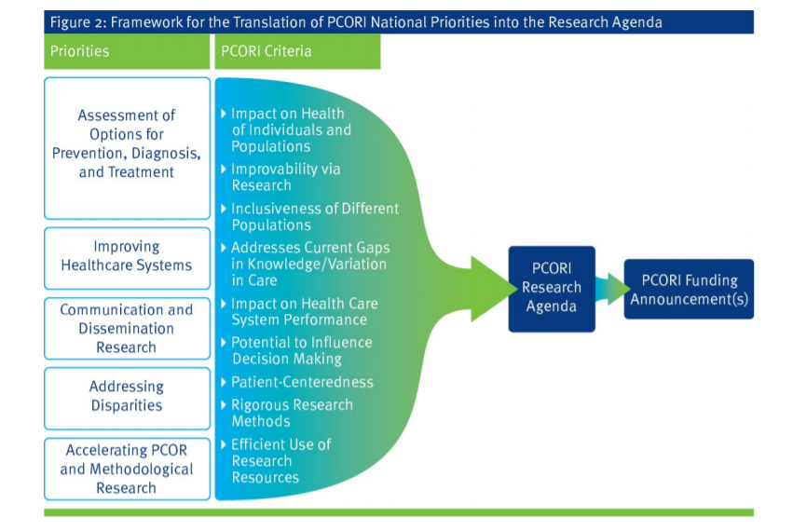
National Priorities for Research and Research Agenda
https://www.pcori.org/sites/default/files/PCORI-National-Priorities-and-Research-Agenda.pdf

Slide 11
PCORI’s reauthorization (December 2019) by Congress: 2 new priority areas
Maternal Morbidity and Mortality
Individual with Intellectual and/or Developmental Disabilities (IDD)
Cycle 1 2021: Increasing Access to and Continuity of Patient-Centered Maternal Care
  Continuing at least through 2021
Cycle 1 2021: Improving Care for Individuals with IDD Growing into Adulthood
  Continuing at least through 2021

Slide 12
Methodology Standards
In any study, methods matter. That’s why we’ve developed methodology standards that patient-centered CER should follow, at a minimum.
Methodology Standards: 16 Broad Categories
Formulating Research Questions | Data Networks
Patient-Centeredness | Causal Inference
Data Integrity and Rigorous Analyses | Adaptive and Bayesian Trial Designs
Preventing/Handling Missing Data | Studies of Medical Tests
Heterogeneity of Treatment Effects | Systematic Reviews
Data Registries | Research Designs Using Clusters
Complex Interventions | Qualitative Methods
Mixed Methods Research | Individual Participant-Level Data Meta-Analysis

Slide 13
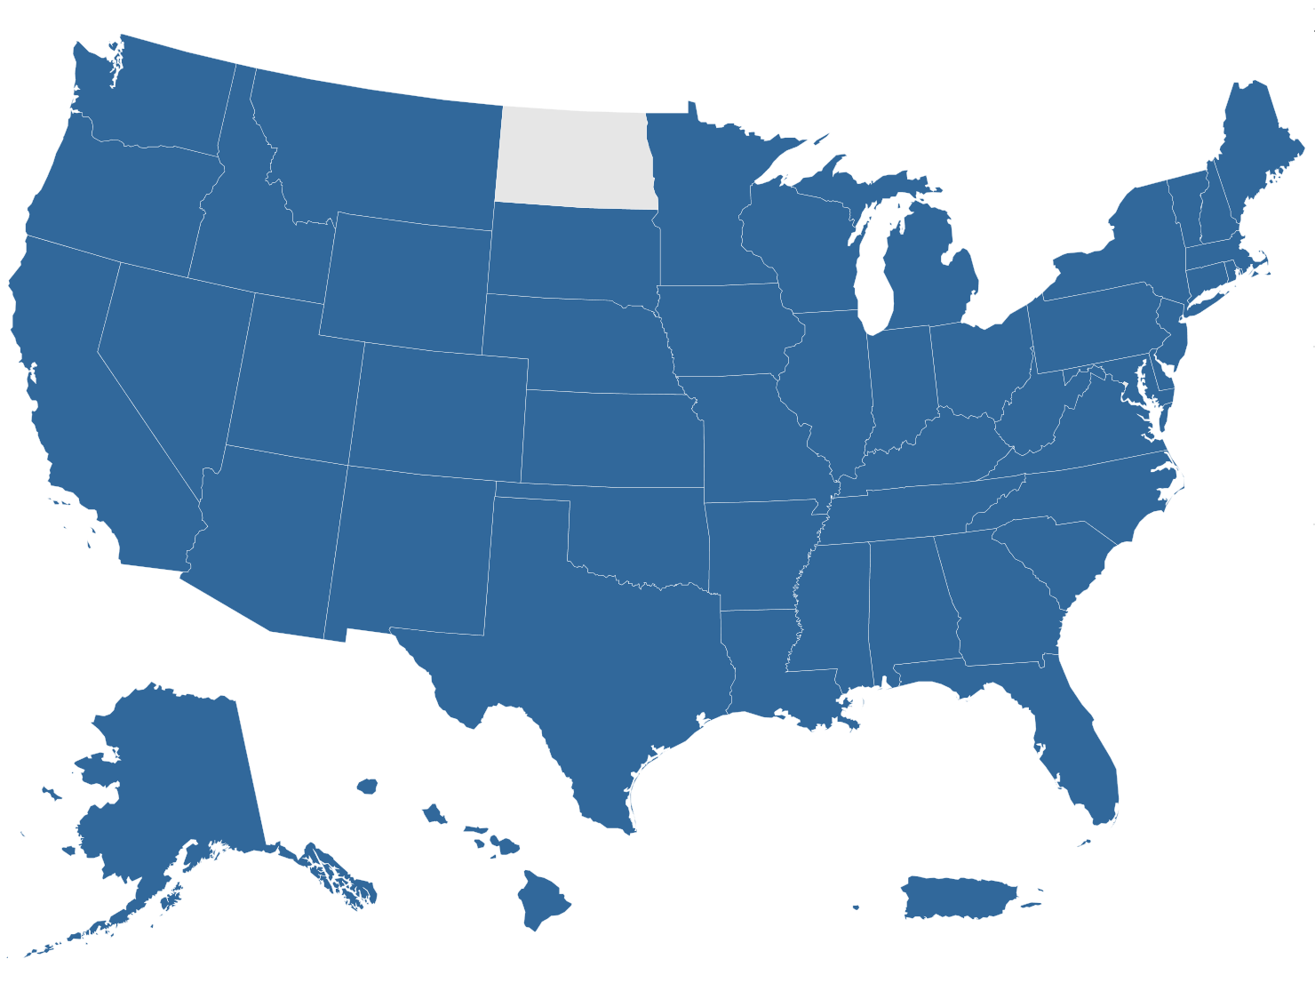
Snapshot of Funded Projects
Number of funded awards:
Nearly 1,800
Amount awarded:
More than $2.9 billion
Number of states where
we are funding projects:
49 (plus the District of Columbia and
Puerto Rico)
AS OF MARCH 2021
All awards
Notes:
Includes ALL AWARDS ever funded by PCORI as of July 2018, namely:
CER studies
D&I awards
Methods studies
Pilot projects
PCORnet awards
Engagement awards
State WITHOUT any funding awarded is North Dakota.
Data source: E&A Portfolio data, QC’d July 23, 2018

Slide 14
PCORI Research Studies: Release of Findings
July 2017 – January 2021

Slide 15
3.
Our Growing
Research Portfolio
https://www.pcori.org/research-results-home

Slide 16
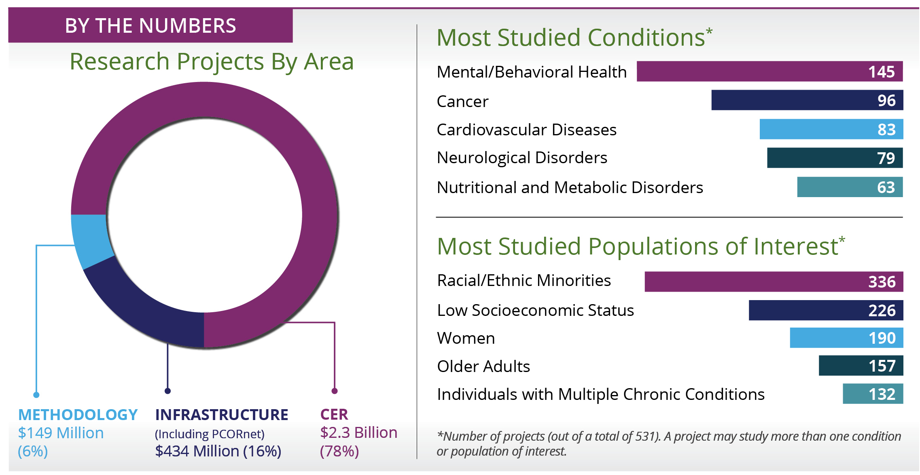
About Our Research Portfolio
AS OF MARCH 2021

Slide 17
Assessment of Prevention, Diagnosis, and Treatment Options
Seeks to fund research that:
    Compares the effectiveness of two or more options that are known to be efficacious, but have not been adequately compared in previous studies
    Factors that account for variation in treatment outcomes

Slide 18

STUDY PROFILE
Physical Therapy vs. Internet-Based Exercise Training for Patients with Knee Osteoarthritis
Potential Impacts
  Compare effectiveness of 2 interventions for patients with knee osteoarthritis
  Methods
  Randomized controlled trial
Engagement
  Doctors, physical therapists, an exercise scientist, and arthritis advocacy organizations comprised an advisory panel who helped researchers decide on study outcomes and recruitment procedures
Randomized 350 adults with knee osteoarthritis to:
Physical therapy
Internet-based exercise training (IBET)
Control
Measured at 4 and 12 months knee pain, stiffness, and function; self-reported physical activity, mental health, social support, and satisfaction with physical function; measured physical ability
Kelli Allen, PhD
University of North Carolina, Chapel Hill, NC
Assessment of Prevention, Diagnosis, and Treatment Options, awarded December 2013
https://www.pcori.org/research-results/2013/comparing-physical-therapy-internet-based-exercise-training-and-no-therapy

Slide 19
STUDY PROFILE
Physical Therapy vs. Internet-Based Exercise Training for Patients with Knee Osteoarthritis
Results*
Compared with control group, the PT group
  Reported more physical activity and stretching
  Performed better on 2-minute march test
  Had higher satisfaction with physical function, fewer sleep problems, less fatigue, and rating of knee symptom
Compared with control group, the IBET group
  Reported more minutes of weekly stretching
  Had a higher overall rating of knee symptom
How can people use the results?
Doctors, patients, and clinic managers can use these results when considering ways to improve function and lessen pain for patients with knee osteoarthritis.
*Osteoarthritis Cartilage. 2018 Mar;26(3):383-396.
Randomized 350 adults with knee osteoarthritis to:
Physical therapy
Internet-based exercise training (IBET)
Control
Measured at 4 and 12 months knee pain, stiffness, and function; self-reported physical activity, mental health, social support, and satisfaction with physical function; measured physical ability
Kelli Allen, PhD
University of North Carolina, Chapel Hill, NC
Assessment of Prevention, Diagnosis, and Treatment Options, awarded December 2013
https://www.pcori.org/research-results/2013/comparing-physical-therapy-internet-based-exercise-training-and-no-therapy

Slide 20
Improving Healthcare Systems
Seeks to fund research on effects of system changes on:
Patients’ access to high-quality support for self-care and coordination across healthcare settings
Experiences important to patients and caregivers, e.g., overall health, functional ability, quality of life, stress, and survival
  Decision making based on patients’ values
Efficiency of healthcare delivery, as measured by the amount of ineffective, duplicative, or wasteful care provided to patients

Slide 21

STUDY PROFILE
Improving Delivery of Patient-Centered Cardiac Rehabilitation
Potential Impact
  Determine best setting of cardiac rehabilitation (CR) practices to improve outcomes in people with cardiovascular disease
Methods
  Natural experiment
Engagement
  Patients, patient advocates, healthcare providers, policy makers, and community members made up a advisory panel that guided the investigators
Evaluated supervised facility-based CR 2-3 times/wk versus minimally supervised home-based CR in 235 people with ischemic heart disease. Outcomes at 3 and 6 months included number of people enrolled in CR; distance in 6-minute walk test; physical activity and function; health-related quality of life; self-efficacy; depression; anxiety; and cognitive function
Mary Whooley, MD
University of California, San Francisco
Improving Healthcare Systems,
awarded September 2013
https://www.pcori.org/research-results/2013/comparing-cardiac-rehabilitation-home-or-clinic-after-hospitalization

Slide 22
STUDY PROFILE
Improving Delivery of Patient-Centered Cardiac Rehabilitation
Results
3 months: patients in home CR could walk further in 6-minutes vs. people in facility CR
  6 months: similar improvement between groups
Home CR: greater improvements in quality of life, physical activity, and anxiety
Facility CR: greater improvement in exercise self-efficacy, memory, and reasoning
How can people use the results?
Medical centers can use these results when considering what kind of CR to offer patients with heart problems.
Evaluated supervised facility-based CR 2-3 times/wk versus minimally supervised home-based CR in 235 people with ischemic heart disease. Outcomes at 3 and 6 months included number of people enrolled in CR; distance in 6-minute walk test; physical activity and function; health-related quality of life; self-efficacy; depression; anxiety; and cognitive function
Mary Whooley, MD
University of California, San Francisco
Improving Healthcare Systems,
awarded September 2013
*
https://www.pcori.org/research-results/2013/comparing-cardiac-rehabilitation-home-or-clinic-after-hospitalization

Slide 23
Communication and
Dissemination Research
Seeks to fund research in:
Clinician engagement with CER
Research translation, decision support interventions, and risk communication
Distribution of CER to patients, caregivers, and providers

Slide 24

STUDY PROFILE
Developing Quality Metrics from Patient-Reported Outcomes for Medical Rehabilitation
Potential Impact
  Can patients with central nervous system (CNS) impairments self-report quality of care?
Methods
  Mixed-methods approach
Engagement
  Patients, clinicians, and others comprised an advisory group to guide the research team
Focus groups with clinicians, former patients, and caregivers to identify quality concepts. 402 inpatients with CNS disorders completed 55 patient-reported outcome measures (PROMs) addressing some of these quality concepts shortly before discharge and 1 month later.
Allen Heinemann, PhD
Northwestern University, Chicago, IL
Communication and Dissemination Research, awarded May 2013
https://www.pcori.org/research-results/2013/it-possible-collect-patient-reported-data-inpatient-rehabilitation-facilities

Slide 25
STUDY PROFILE
Developing Quality Metrics from Patient-Reported Outcomes for Medical Rehabilitation
Results*
1st survey
  Took ~15 minutes to complete
  73% of patients completed without help
  > 95% of patients were willing to collect PROM
Follow-up survey
  71% of patients completed the follow-up survey
  Patients with ADL difficulty and those who did not go home: less likely to complete follow-up survey
How can people use the results?
IRFs could consider using surveys to help understand the views of patients who have CNS problems on the quality of their care.
* Arch Phys Med Rehabil. 2019 Jun;100(6):1032-1041.
Focus groups with clinicians, former patients, and caregivers to identify quality concepts. 402 inpatients with neurological disorders completed 55 patient-reported outcome measures (PROMs) addressing some of these quality concepts shortly before discharge and 1 month later.
Allen Heinemann, PhD
Northwestern University, Chicago, IL
Communication and Dissemination Research, awarded May 2013
https://www.pcori.org/research-results/2013/it-possible-collect-patient-reported-data-inpatient-rehabilitation-facilities

Slide 26
Addressing Disparities
Seeks to fund research that:
Compares interventions to reduce or eliminate disparities in patient-centered outcomes
  Address contextual factors
  Healthcare options across different patient populations
Compares and identifies best practices within various patient populations for information sharing about outcomes and research

Slide 27

STUDY PROFILE
A Comprehensive Disease Management Program to Improve Quality of Life in Disparity Hispanic and African American Patients Admitted with Exacerbation of Chronic Pulmonary Diseases
Potential Impact
  Compare with telerehabilitation is effective compared with in-person rehabilitation
Methods
  Community-based participatory research (CBPR) approach; Randomized controlled trial
Engagement
  Patients, caregivers, and healthcare providers comprised a community advisory board and gave input on the study, including patient recruitment strategies and interpretation of study results
Project compares tele-PR to in person PR in 209 people with COPD. The PR was 16 guided rehab sessions with respiratory therapists over 8 weeks. Outcomes were measured at baseline, and 2, 6, and 12 months and included hospital readmissions, mortality, quality of life, functional capacity, COPD symptoms, COPD knowledge, social, support, depression, and anxiety.
Negin Hajizadeh, MD, MPH
University of California, Los Angeles
Addressing Disparities, awarded July 2016
https://www.pcori.org/research-results/2016/testing-whether-referral-telehealth-program-helps-african-american-and

Slide 28
STUDY PROFILE
A Comprehensive Disease Management Program to Improve Quality of Life in Disparity Hispanic and African American Patients Admitted with Exacerbation of Chronic Pulmonary Diseases
* JMIR Form Res. 2020 Jan 31;4(1):e13197.
Initial Results*
85/209 completed at least 1 rehab session
6 months: no difference between tele-PR and in-person PR in any outcome
How can people use the results?
Doctors can use these results when considering ways to help patients with COPD avoid hospital stays.
Project compares tele-PR to in person PR in 209 people with COPD. The PR was 16 guided rehab sessions with respiratory therapists over 8 weeks. Outcomes were measured at baseline, and 2, 6, and 12 months and included hospital readmissions, mortality, quality of life, functional capacity, COPD symptoms, COPD knowledge, social, support, depression, and anxiety.
Negin Hajizadeh, MD, MPH
University of California, Los Angeles
Addressing Disparities, awarded July 2016
https://www.pcori.org/research-results/2016/testing-whether-referral-telehealth-program-helps-african-american-and

Slide 29
Improving Methods for Conducting Patient-Centered Outcomes Research
Seeks to fund investigator-initiated research that addresses gaps in methodological research to benefit all healthcare stakeholders.
General analytic methods
  Design-specific analytic methods
  Analytics for data networks
Usability, interpretability, and clinical meaningfulness of patient-reported outcomes
Methods for patient and other stakeholder engagement in research
Issues related to human subjects protections
Improving methods of recruitment and retention of participants into PCOR/CER

Slide 30

STUDY PROFILE
Better Rehabilitation Through Better Characterization of Treatments: Development of the Manual for Rehabilitation Treatment Specification
Potential Impact
Rehab treatments often lack a common definition
Using a standard definition of rehab treatments may help researchers compare treatments
Methods
  Theoretical development
Engagement
  A stakeholder advisory panel of rehab providers, educators, researchers, and patients
Used a multi-stage iterative development using expert consensus to develop a rigorously tested manual of rehabilitation treatments to define rehab. The draft manual was implemented by 40 rehab providers who gave feedback.
John Whyte, MD, PhD
Moss Rehabilitation Research Institute,
Elkins Park, Pennsylvania
CER Methods,
awarded September 2014
https://www.pcori.org/research-results/2014/creating-manual-better-define-rehabilitation-treatments

Slide 31
STUDY PROFILE
Better Rehabilitation Through Better Characterization of Treatments: Development of the Manual for Rehabilitation Treatment Specification
Results*
The Rehabilitation Treatment Specification System
3 types of treatments
  Body functions: focus on making a body part work better (e.g., helping someone increase their grip strength)
  Skills and habits: focus on helping people get better at doing something that needs practice (e.g., walking)
  Representations: focus on thoughts, feelings, and knowledge (e.g., learn about falling risk factors)
2 parts for each rehab treatment
  Target: specific functional problem the patient has (e.g., trouble walking fast)
  Ingredients: things that make up a treatment (e.g., activities, procedures, or medicines)
* Arch Phys Med Rehabil. 2019 Jan;100(1):146-155
Used a multi-stage iterative development using expert consensus to develop a rigorously tested manual of rehabilitation treatments to define rehab. The draft manual was implemented by 40 rehab providers who gave feedback.
John Whyte, MD, PhD
Moss Rehabilitation Research Institute,
Elkins Park, Pennsylvania
CER Methods,
awarded September 2014
https://www.pcori.org/research-results/2014/creating-manual-better-define-rehabilitation-treatments

Slide 32
Pragmatic Clinical Studies
Seek to produce information that can be directly adopted by providers:
Compares two of more options for prevention, diagnosis, treatment, or management of a disease or symptom
Addresses critical clinical choices faced by patients, caregivers, clinicians, and systems
Often conducted in routine clinical settings
  Though often large, usually less complex protocols than traditional trials

Slide 33

STUDY PROFILE
PRO-ACTIVE: Comparing the Effectiveness of Prophylactic Swallow Intervention for Patients Receiving Radiotherapy for Head and Neck Cancer **Recruiting**
Potential Impact
Patients with head and neck cancer often develop swallowing problems after getting radiation treatment
May identify when SLP should be initiated
  Some get help before swallowing problems begin
  Other get help only after swallowing problems
Methods
  Randomized controlled trial
Engagement
  Patients, caregivers, and healthcare providers and administrators comprise a stakeholder advisory panel to help plan and conduct the study
Randomizes 952 patients with head and neck cancer without swallowing problems to:
Proactive Eat All Through Radiation Therapy (EAT) therapy
Proactive EAT and exercise therapy
Reactive therapy
Follows for 1 year and measures ability to eat by mouth without a feeding tube; swallowing-related quality of life; cancer symptom severity; swallowing strength; secondary symptoms related to swallowing difficulty (e.g., malnutrition or aspiration); weight loss, cancer coping ability
Rosemary Martino, PhD
University Health Network, Toronto, Ontario, Canada
PCS,
awarded September 2017
https://www.pcori.org/research-results/2017/comparing-treatments-help-patients-head-and-neck-cancer-address-problems

Slide 34

PCORnet®: The National Patient-Centered Clinical Research Network
An innovative initiative funded by the Patient-Centered Outcomes Research Institute (PCORI), PCORnet is a large, highly representative, national patient-centered clinical research network.
Our vision is to support a learning U.S. healthcare system and to enable large-scale clinical research conducted with enhanced quality and efficiency.
Our mission is to enable people to make informed healthcare decisions by efficiently conducting clinical research relevant to their needs.
https://pcornet.org/

Slide 35

STUDY PROFILE
Aspirin Dosing: A Patient-Centric Trial Assessing Benefits and Long-term Effectiveness (ADAPTABLE)
Potential Impact
  Demonstrate PCORnet’s capability to conduct important CER efficiently and economically
  Identify the optimal dose of aspirin for secondary prevention of heart attacks and stroke in patients with heart disease
Methods
  Individual-randomized pragmatic clinical trial to compare the effectiveness of two doses of aspirin, using the PCORnet Common Data Model as a key data source
Engagement
  Adaptors patient group involved throughout the trial, contributing to design, start-up, enrollment, follow-up, analysis, and dissemination
An innovative pragmatic clinical trial conducted within the PCORnet infrastructure to determine the optimal daily aspirin dose (325 mg versus 81 mg) for patients with heart disease. The trial leverages existing electronic health records, which link to insurance claims. A web‐based patient portal collects patient‐reported outcomes and additional patient-encounter data. and continues to refine.
Matthew T. Roe, MD, MHS
Associate Professor of Medicine, Duke Cardiology
CER Methods and Infrastructure,
awarded April 2015
https://www.pcori.org/research-results/2015/comparing-two-aspirin-doses-prevent-heart-attacks-and-strokes-people-living

Slide 36
4.
Better Research Through Engagement
https://www.pcori.org/engagement

Slide 37

Why Engage?
To influence research to be patient-centered, relevant, and useful
  To establish trust and a sense of legitimacy in research findings
To encourage successful uptake and use of research results
  *Health Expectations 2014; 17(5): 637–650.
Notes:
Literature search from 1995-2009 identified 66 studies
Analysis showed patient and public involvement enhanced quality and appropriateness of research
Impacts were described for all stages of research
But authors note the evidence base on impact of engagement still needs significant enhancement

Slide 38
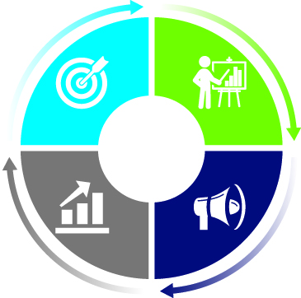
Engagement as a Path to Useful,
High-Quality Research
Topic Selection and Research Prioritization
Proposal Review; Design and Conduct of Research
Dissemination and Implementation of Results
Evaluation
Engagement in Health Research Literature Explorer
Notes:
This searchable, catalogued resource for peer-reviewed literature can help identify publications about engagement
It contains over 1,600 articles that include:
Examples of engagement in health research
Evaluations of engagement in health research
Syntheses of engagement methods and impacts
Frameworks, editorials, and commentaries on engagement in health research

Slide 39
Engagement Award Funding Opportunities
Engagement Award: Dissemination Initiative
Objective: Support communities and organizations to actively disseminate PCORI-funded research findings and/or develop partnerships and
infrastructure to disseminate and implement PCORI-funded research findings
Engagement Award: Stakeholder Convening Support
Objective: Convene stakeholders to explore critical issues related to PCOR/CER and/or communicate PCORI-funded research findings to targeted end-users
Engagement Award: Capacity Building
Objective: Prepare patients and stakeholders to participate as partners in PCOR/CER
Up to
$250,000
2 years
Up to
$100,000
1 year
Up to
$250,000
2 years
https://www.pcori.org/engagement/eugene-washington-pcori-engagement-awards
Notes:
The Engagement Award program is PCORI’s funding mechanism for research support projects (so not for the actual conduct of research).
I’d like to share with you information about the different competitive funding opportunities we have for dissemination-related activities that may be of interest to you.
The first is a brand new award to support dissemination initiatives. It’s a an award for up to $300,000, for projects up to two years in duration. The intent is to support organizations and communities in actively disseminating PCORI-funded research findings. We want to fund projects aimed at spreading awareness and increasing knowledge of evidence from PCORI-funded research, targeted directly to patients, clinicians, and others who can use this information to inform their healthcare decisions.
We are looking at you all as “trusted sources” of information for your members. (As we recently heard) You know how your members like to receive information, how they use it. So, rather then focusing OUR efforts on trying to get the evidence directly to your members, we’d like to provide funding support to you to do some of this important work.
Additionally, we have funding for Conferences. This is a smaller award – up to $50,000 to fund conferences or portions of a conference. This funding could be used to convene your members around a specific PCORI-funding research finding, with an intent to increase awareness of the evidence, and people’s ability to use and apply it.
Finally, the third award we have is intended for organizations and communities who do not have the necessary infrastructure and partnerships in place for dissemination and potential uptake of research findings. This is funding for those groups to develop, demonstrate, and evaluate the processes/pathways/mechanisms necessary to incorporate PCOR/CER results into decision-making settings.

Slide 40
5.
Information for Applicants

Slide 41
Who Can Apply?
Any private-sector research organization, including:
Non-profit or for-profit organization
Laboratory or manufacturer/industry
Any public sector research organization, including:
University or college (including affiliated clinician group)
Hospital or healthcare system (including affiliated clinician group)
Units of state, local, or federal government
Foreign organizations and nondomestic components of US organizations, if there is a clear benefit to the US healthcare system and patient-centered research efforts
Note: Individuals may not apply

Slide 42
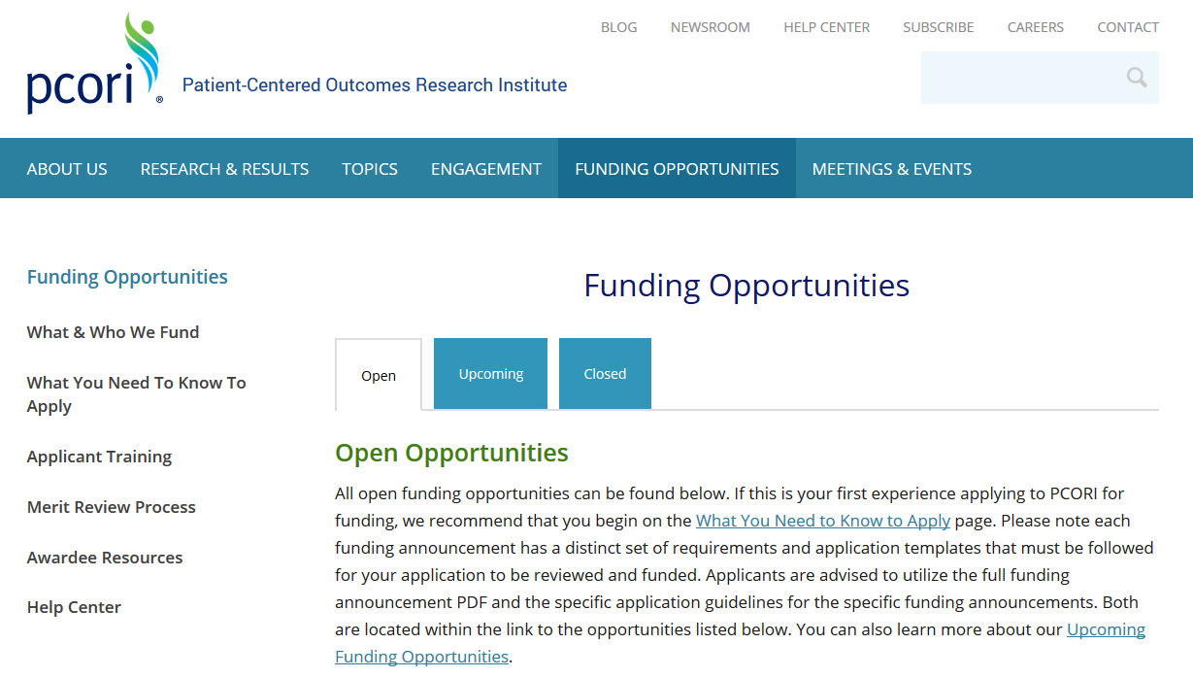
PCORI Funding Opportunities
Our research funding is awarded through PCORI Funding Announcements
Open opportunities are posted at pcori.org/apply
Check out ‘Open’ and ‘Upcoming’ announcements

Slide 43
What You Need to Know to Apply
Step 1: Learn What We Fund
Step 2: Learn What We Don't Fund
  Research aimed primarily at developing and validating an instrument
  Cost-effectiveness analysis measuring cost per quality-adjusted life-year
  Comparisons that focus on the relative costs of care as the primary criterion for choosing between alternatives
  Most projects that do not include patients or other healthcare stakeholders throughout the research process, unless they are highly technical or methodological projects
https://www.pcori.org/funding-opportunities/what-you-need-know-apply

Slide 44
What You Need to Know to Apply
Step 3: Select the Funding Opportunity that Best Aligns with Your Proposed Research
  Broad PCORI Funding Announcements (PFA) (up to $3M 3 years [small] and $5M 5 years [large]; Communication and Dissemination (up to $2M 3 years)
  Improving Methods for Conducting PCOR PFA (up to $750,000 3 years)
  Pragmatic Clinical Studies PFA (up to $10M 5 years)
  Phased Large Awards for CER PFA (up to $22M 6.5 years)
  Special One-Time Funding Opportunities
  Targeted PFA
Step 4: Apply for a Research Award​
  Submission Guidelines
https://www.pcori.org/funding-opportunities/what-you-need-know-apply

Slide 45
Targeted Funding Announcements
Cycle 2 2021 - Opened May 4, 2021 (LOI due June 1, 2021)
  Improving Postpartum Maternal Outcomes for Populations Experiencing Disparities (up to $5M [small awards]; $15M [large awards] 5 years)
  Comparative Effectiveness of Interventions Targeting Mental Health Conditions in Individuals with Intellectual and Developmental Disabilities (up to $3M 3 years)
  Nonsurgical Options for Women with Urinary Incontinence (up to $5M 5 years)
Cycle 3 2021 or 2022 - Future targeted funding announcements
  Healthy aging: Optimizing physical and mental function across the aging continuum
  Osteoporotic fracture prevention
  Migraine prevention
  Addressing racism, discrimination and bias throughout the care continuum
  Leveraging telehealth for chronic disease management among vulnerable populations with complex needs
https://www.pcori.org/news-release/more-dozen-high-priority-research-topics-approved-future-pcori-funding-opportunities

Slide 46
6.
How We Review Research Proposals

Slide 47
Our Merit Review Process
    Evaluate Letters of Intent. At least two PCORI staff review each Letter of Intent and a committee of staff members determines which will be invited to submit full applications. Information in the Letters of Intent drives the recruitment of patients, clinicians, scientists, and other members of the healthcare community who have the appropriate expertise to serve on merit review panels.
1
    Preliminary review of full applications. Reviewers conduct a preliminary review of applications, providing written critiques and scores for the applications based on our review criteria and scoring system.
2

Slide 48
Our Merit Review Process
3
    In-person panel review. Following the preliminary review, a subset of applications move forward and are discussed and scored by the full panel of merit reviewers at an in-person meeting. The perspectives of a wide range of reviewers help us choose projects that are important, practical, and relevant to the audiences who will use the results of our work.
    Selection Committee Review. Program staff recommend projects to a Selection Committee that includes members of PCORI’s Board of Governors. The committee identifies a slate of applications for possible funding based on merit review scores, programmatic balance and fit, and PCORI’s strategic priorities.
    This slate is proposed to PCORI’s Board for consideration and approval.
4

Slide 49
Our Merit Review Process
 | Patient/Other Stakeholder Reviewers | Scientist Reviewers
Criterion 1: Potential for the study to fill critical gaps in evidence: Addresses a clinical uncertainty or decisional dilemma |  | ✓
Criterion 2: Potential for the study findings to be adopted into clinical practice and improve delivery of care: potential to lead to improvements in clinical practice and patient outcomes | ✓ | ✓
Criterion 3: Scientific merit (research design, analysis, and outcomes): research design of sufficient technical merit to ensure that the study goals will be met |  | ✓
Criterion 4: Investigator(s) and environment: appropriate investigators, as well as an environment with sufficient capacity |  | ✓
Criterion 5: Patient-centeredness: improving patient-centered outcomes and employs a patient-centered research design | ✓ | ✓
Criterion 6: Patient and stakeholder engagement: patients and other stakeholders as partners throughout the entire research process | ✓ | ✓

Slide 50

What We Mean By…
    “Patient-centeredness”
    The project aims to answer questions or examine outcomes that matter to patients within the context of patient preferences
    Research questions and outcomes should reflect what is important to patients and caregivers
    “Patient and stakeholder engagement”
    Patients are partners in research, not just “subjects”
    Active and meaningful engagement between scientists, patients, and other stakeholders
    Community, patient, and caregiver involvement already in existence or a well-thought-out plan

Slide 51
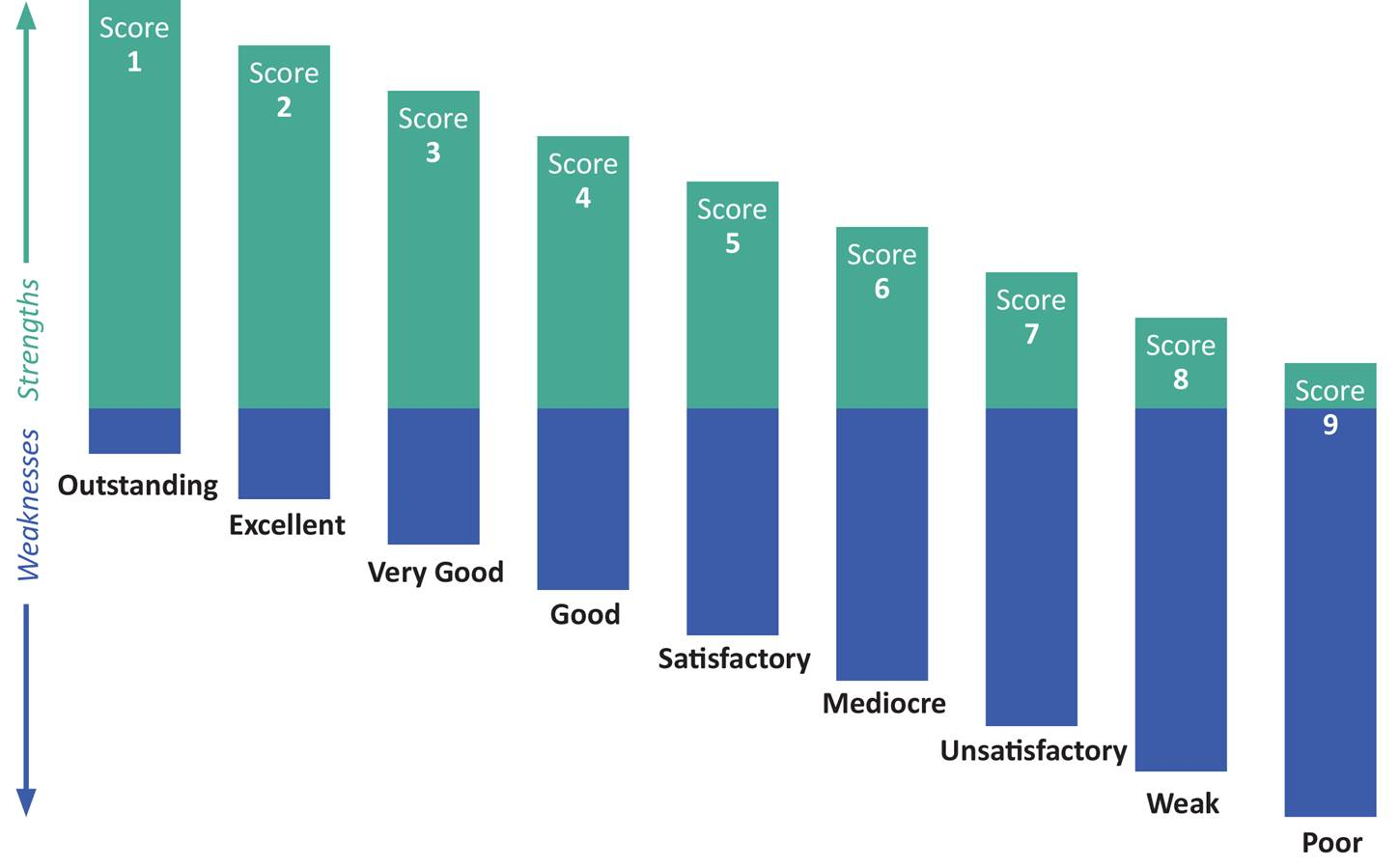
Scoring Range

Slide 52
7.
Getting the Word Out
Dissemination and Implementation (D&I)

Slide 53
PCORI D&I Program Funding Initiatives
Goal: To facilitate the uptake and integration of evidence from PCORI-funded studies into real-world practice, in the context of other relevant evidence
Limited Competition: Implementation of PCORI-Funded PCOR Results PFA
  Provides PCORI investigator teams the opportunity to propose next steps to put their findings into practice (up to $1.5M in total direct costs for Standard Implementation Projects, up to $4.5M in total direct costs for Phased Implementation Projects, up to $300,000 in total costs for Dissemination Projects)
Implementation of Effective Shared Decision Making Approaches in Practice Settings PFA
  Promotes the implementation and systematic uptake of shared decision making in practice settings (up to $1.5M in total direct costs per project)
Implementation of Findings from PCORI’s Major Research Investments PFA
  Provides a broad applicant pool the opportunity to promote the uptake of peer-reviewed findings from specific, high-priority PCORI initiatives into practice, in the context of related evidence (up to $2.5M in total costs per project)

Slide 54
202.827.7700
info@pcori.org

Slide 55
Thank You!
Meghan Warren
mwarren@pcori.org

